Slide 1
Joint Clinical Meeting OSCE
07 Nov 2018
KWH

Slide 2
Case 1
10/Boy
PMHx: asthma
Mild URTI symptoms x 1 week
Sudden onset of SOB at home, increasing in severity
Given ventolin puff at home but no improve
Upon AED arrival:
Lethargic, obey command, CR <2 sec
HR 150, SaO2: 98% on non rebreathing mask
RR: 44-50
Chest: poor AE with expiratory wheeze

Slide 3
Case 1 (Questions)
How do you classify the severity of acute exacerbation of asthma?
What is the severity of this patient?
What is the management plan?
If you decided to intubate the patient, what induction agent you would use?
What ventilation strategy would be use in the patient?

Slide 4
Case 2
62/M
History thyrotoxicosis with recently thyroidectomy done
C/O dizziness, both hands and feet numbness and generalized weakness
PE: Muscle spasm and twitching, brisk reflexes
Chest/CVS/Abdomen: NAD

Slide 5
Case 2

Slide 6
Case 2 (Questions)
What is the provisional diagnosis?
What further examination you would like to do?
From the ECG, what do you worry about?
How do you manage this patient?

Slide 7
Case 3
22/M Good past health
vomiting then collapsed at home
taken unknown med, unknown time of ingestion
arrived at emergency department with the following vital signs:
Temp 37
BP 120/70
P 100 in sinus rhythm
RR 14
SaO2 98% on non-breathing mask
GCS 3/15 with pin-point pupils

Slide 8
Case 3 (Questions)
What is the initial management plan?
After the initial management in 1, the ECG suddenly changed.
Please describe the ECG
What is the subsequent management?

Slide 9
Case 3 (Questions)
The AXR showed radio-opaque substance in stomach.
Please list 3 drugs are radiopaque on x-ray.
What is the likely drug in this patient?

Slide 10
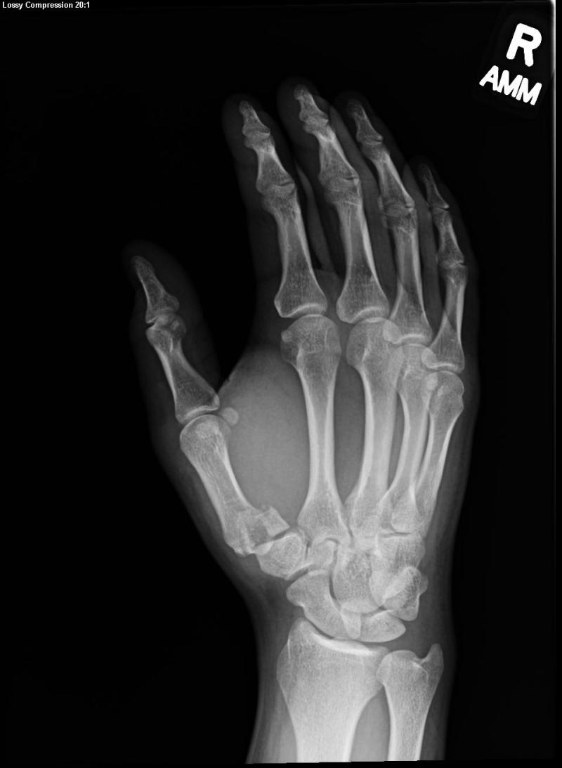
Case 4
27 Male
Complained of right
thumb pain when
practicing boxing

Slide 11
Case 4 (Questions)
Please describes the x-ray finding
What is the named of the fracture?
What is the common mechanism of injury?
What is the management plan?

